Slide 1
Factorial Design

Slide 2
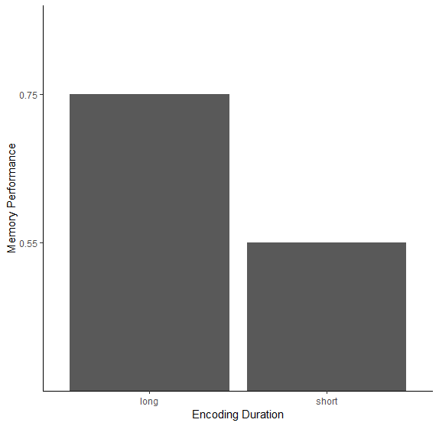
Experimental Design
Keep it simple, when possible
One IV: One DV
Effects of encoding duration on memory performance
IV – 2 levels (long and short)
DV – memory performance

Slide 3
2 or more IVs
Two or more IVs: (still one DV)
Effects of encoding duration and repetition on memory performance
Independent variable 1
Encoding duration (long and short durations)
Independent variable 2
Repetition (See item once or twice)
Dependent variable
Memory performance

Slide 4
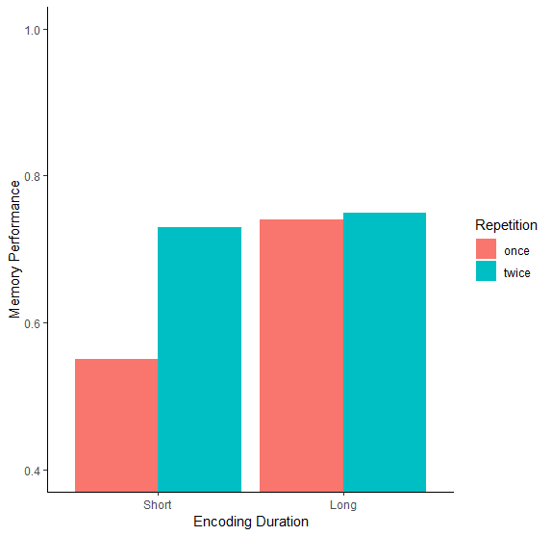
2 or more IVs

Slide 5
Terminology
Independent Variable = Factor
Short vs. Long Duration = One-Factor Design
Short vs. Long Duration, One vs. Two Repetition = Two-Factor Design
Levels of each factor
Duration: 2 levels (short,long)
Repetition: 2 levels (one, two)

Slide 6
Terminology
Factor A (levels) x Factor B (levels)
2x2 Factorial Design
2 (Duration: Short,Long) x 2 (Repetition: One,Two)
Adding Levels
2x3
2 (Duration: Short,Long) x 3 (Repetition: One, Two, Three)
Adding Independent Variables
2x3x2
2 (Duration: Short,Long) x 3 (Repetition: One, Two, Three) x 2 (Age: Young, Old)

Slide 7
Terminology
Between-subjects
All factors are measured between-subjects.
Mixed Design
One factor is measured between-subjects, and one factor is measured within-subjects
Short Duration Repeat Once N = 30 | Short Duration Repeat Twice N = 30
Long Duration Repeat Once N = 30 | Long Duration Repeat Twice N = 30
Short Duration Repeat Once & Repeat Twice N=30 | Long Duration Repeat Once & Repeat Twice N=30

Slide 8
Interpreting Results
Main effect:
Looking at one IV without taking others into account
Interaction
Differences between levels of IV across other IVs
Simple effects:
Difference between levels of each combination of IV

Slide 9
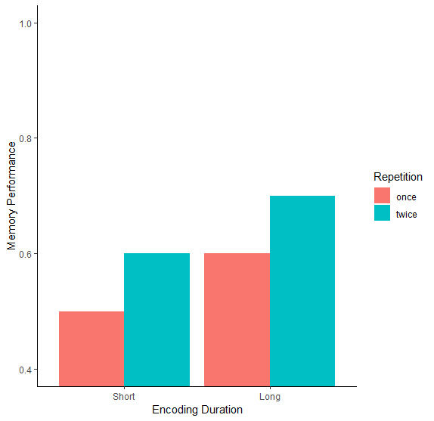

Slide 11
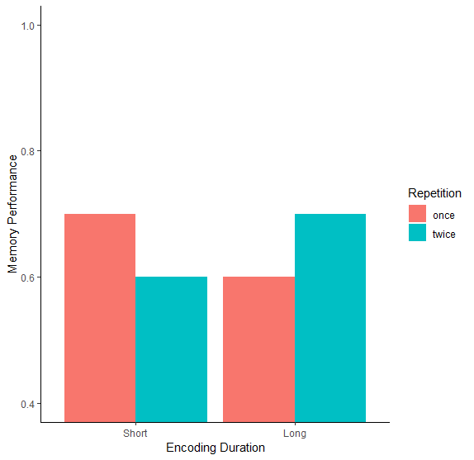

Slide 12
More terms
Interactions…
Spreading Interactions: When one level of an IV has an effect on another factor, and another level of the IV remains the same

Slide 13
More terms
Interactions…
Crossover Interactions: When an IV has an effect on both levels of the other IV, but in opposite directions

Slide 14
Examples
2x2 Factorial Design
Factor 1: Study environment
Level 1: Quiet
Level 2: Music
Factor 2: Presence of snacks
Level 1: snacks
Level 2: no snacks
Main effect of study environment
No main effect of snacking
No interaction

Slide 15
Examples
2x2 Factorial Design
Factor 1: Medication Dose
Level 1: Medication
Level 2: No Medication
Factor 2: Use of Therapy
Level 1: Therapy
Level 2: No Therapy
Main effect of medication
Main effect of therapy
Interaction

Slide 16
Examples
2x2 Factorial Design
Factor 1: Supplements
Level 1: Herbal
Level 2: Nothing
Factor 2: Use of Hypnosis
Level 1: Hypnosis
Level 2: No Hypnosis
No main effect of supplement
No main effect of hypnosis
No interaction

Slide 17
Examples
2x2 Factorial Design
Factor 1: Study Environment
Level 1: Study on land
Level 2: Study underwater
Factor 2: Recall environment
Level 1: Recall on land
Level 2: Recall underwater
No main effect of study environment
No main effect of test environment
Crossover interaction

Slide 18
Examples
2x2 Factorial Design
Factor 1: Type of Exercise
Level 1: Cardio
Level 2: Strength
Factor 2: Time of exercise
Level 1: Morning
Level 2: Evening
Main effect of type of exercise
No main effect of time of exercise
No interaction

Slide 19
3 Factor Interactions
2x2x2 Factorial Design
Still look for main effects & still look for interactions
3-way interaction
One interaction 2x2 interaction is different from another interaction

Slide 20
3-way interaction in a 2x2x2

